Slide 1
Bob Watson and Larry Stone
Unintended Health and Environmental Consequences
of CAFO Agriculture

Slide 2
This presentation will present the perspective that CAFOs are wastewater technology which has been inappropriately transferred to agriculture.
Using this perspective, we will provide a context that will give you a different way to view this CAFO model of agriculture.

Slide 3
Unintended consequences have occurred:
• because the unregulated sector of agriculture adopted technologies designed for use in industrial/municipal sewage treatment;
• but the training, regulations, and engineering used in the wastewater industry have not been carried over to industrial agriculture.

Slide 4
4
We discuss:
• the technology,
• its inherent industrial poisons,
• its effects on people’s health, and
• how people can be protected.
We avoid:
• emotional arguments about animals,
• the treatment of animals,
• private property, and
• models of agriculture.
We simply address the interface between industrial poisons and the public.

Slide 5
This manure collection technology has produced unintended consequences. Some include:
• the release of air-borne toxins
• hydrogen sulfide (H₂S),
• methane (CH₄),
• ammonia (NH₃), and
• particulates;
• explosive conditions inside the confinements; and
• nitric acid rain.

Slide 6
6
This is not a blame game.
No one originally understood the human health costs, environmental degradation, and pollution that would result from using these technologies in agriculture.
As such, we should all bear the costs of transitioning to a biologically benign agriculture.

Slide 7
Please keep in mind during this presentation that the focus of most individuals, corporations, and government entities is
“you can’t regulate poisons coming from agriculture,”
rather than focusing on the uncomfortable fact that
“people - especially children - are breathing poisons from agriculture.”

Slide 8
This presentation will include:
1. An explanation of the technology that creates the same sewer environments in both CAFOs and the wastewater industry.
2. A discussion of the regulations and design that have matured with this technology, but that have not been transferred to agriculture with that technology.
3. We will dispel some common myths.
4. Then we will proceed to specific examples of unintended consequences:
• North Winneshiek school children.
• Increase of deaths and fires in confinements from foaming problems.
• The new acid rain - nitric acid rain - much of which can be traced to agriculture.

Slide 9
I. Common Myths
“This is a valuable manure.” It is not!
Today waste sits and “cooks” (anaerobic digestion) for months in pits, tanks, or lagoons, constantly generating and sending poison sewer gases and particulates into the surrounding neighborhood and larger environment. And it becomes toxic before being applied to fields.
For thousands of years, manure used to be deposited directly to the land by animals, or frequently spread by farmers. It broke down into its constituent parts within three days.
Relative pollution numbers:
Treated Human Waste Raw Human Waste Confinement Waste
CBOD 25 200 1000
TSS 30 200 1000+
Ammonia/Nitrogen 1-5 15-20 300-400
Because hog manure is five times more polluting than human waste, and because we have ~10 million hogs at any one time being raised in the state, it is like having 50 million people in Iowa having their waste collected but not treated and spread directly onto the land.

Slide 10
Common Myths continued…
“The odor is merely a nuisance, with no health problems.” There ARE health problems.
Kline Study
Merchant Study
Original Watson article
“Technology can fix any problem.” No, it can’t.
Any time there is fecal waste decomposing in a pit, there must be poison gases being produced. If you use this technology, this will happen.
These problems are prior to and separate from any treatment.
Because people and animals are in proximity to the pit, there is no technological fix.
“Confinements and feedlots are regulated.” Not really.
The only rules are about where waste may be spread.
There are no wastewater regulations.
EPA lost lawsuit on requiring NPDES permits for CAFOs.

Slide 11
Common Myths continued…
“Opponents are urban activists.” They are not.
In our 15 years going to many counties in Iowa, we’ve learned that most opponents are farmers, farm wives, children and farm widows.
Rural neighbors of CAFOs are most affected. Many CAFOs are built close to neighbors.
Most CAFOS are not associated with what we would consider a farmstead.
“We must keep this model because it gives us cheap food.” It does not.
Government subsidies and the externalization of soil loss, pollution and human health costs make this model cheap.
A model that poisons and pollutes poses moral/ethical questions, which cannot be reduced to monetary figures.

Slide 12
Sewer Pipe
Confined Space
Anaerobic Digester
Confinement
Similarities Between CAFOs and Waste Water Treatment:
Both are closed spaces.
Both have untreated fecal waste in them.
That waste constantly generates poison sewer gases: hydrogen sulfide, ammonia, the explosive and green-house gas methane, and particulates.
Inherent in the technology
Causes of diseases and death from those gases are the same.
Constant ventilation is needed to survive in either.
These factors define sewer environments. They are the same.

Slide 13
Sewer Pipe
Confined Space
Anaerobic Digester
Confinement
Differences Between CAFOs and Waste Water Treatment:
Sewers are designed to contain the poison gases, while confinements are designed to blow poison gases into the surrounding neighborhood.
The waste in sewers is ultimately treated; confinement waste is not treated. Problems are prior to treatment, and would exist even if waste was treated.
There are no regulations for confinements that provide for educating and training about (and protections from) a hazardous work place.
There are no regulations protecting the public from the poisons in confinements. There ARE such regulations for sewage treatment, and for everywhere else in which there is fecal waste producing hydrogen sulfide, ammonia, and methane gases in a closed structure.

Slide 14
Summary of toxicology for Hydrogen Sulfide
High Concentrations
respiratory paralysis…may cause coma after a single breath and may be rapidly fatal.
convulsions.
acute conjunctivitis with pain, lacrimation, and photophobia.
keratoconjunctivitis and vesiculation of the corneal epithelium.
pulmonary edema.
rhinitis, pharyngitis, bronchitis, and pneumonitis.
rapid olfactory fatigue.
Low Concentrations
irritates the eyes and respiratory tract.
headache, fatigue, irritability, insomnia, and gastrointestinal disturbances.
dizziness.

Slide 15
Summary of toxicology for Ammonia
Ammonia vapor is a severe irritant of the eyes, especially the cornea, the respiratory tract, and skin.
Dyspnea, bronchospasm, chest pain and pulmonary edema which may be fatal.
Bronchitis and pneumonia.
Asthma.
Ironically, a 1969 study to set human limits for ammonia was done on pigs.
Stombaugh DP, Teague HS, & Roller WH (1969 June). Effects of atmospheric ammonia on the pig. Journal of Animal Science, 28(6): 844-847.

Slide 16
II. Rural Schools, Confinements and Poison Sewer Gases
16
This section will:
• explore the relationship between rural schools and confinements, and the incidence of airborne diseases in children due to their proximity to these confinements.
• provide information about conditions at the North Winneshiek Community School, and will
• recount attempts to remedy the negative impact of CAFOs on the school environment at North Winn.
• give you an understanding of how you can at least protect children when they are inside your school buildings with the correct HVAC filters.

Slide 17
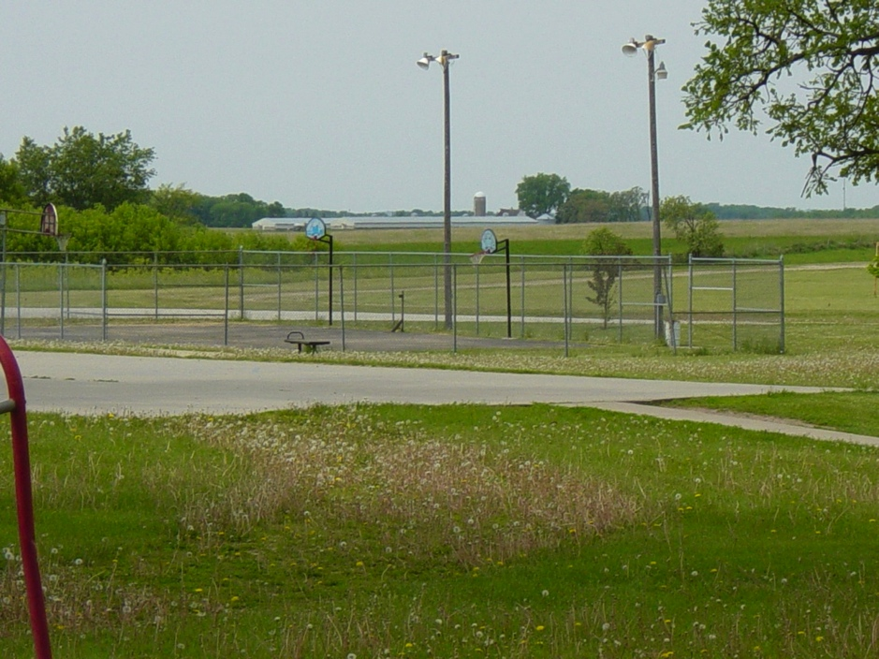

Slide 18
Asthma and Farm Exposures in a Cohort of Rural Iowa Children (2005)
• Environmental Health Perspectives, 113(3): 350-356.
• James A. Merchant, Allison L. Naleway, Erik R. Svendsen, Kevin M. Kelly, Leon F. Burmeister, Ann M. Stromquist, Craig D. Taylor, Peter S. Thorne, Stephen J. Reynolds, Wayne T. Sanderson, and Elizabeth A. Chrischilles
School Proximity to Concentrated Animal Feeding Operations and Prevalence of Asthma in Students (2006)
• CHEST,* 129(6): 1486-1491.
• Sigurdur T. Sigurdarson and Joel N. Kline
* = Journal of the American College of Chest Physicians

Slide 19
The Two Studies in Brief
Iowa’s overall rate of asthma is about 6.7%.
• To generalize the studies, it has been found that if a rural school has a confinement within 10 miles, 11.7% of the children exhibit asthma health outcomes – nearly twice the state rate.
• If a confinement is within ½ mile of a school, 24.6% of children exhibit asthma health outcomes – four times the state rate.
• And if you are a kid unlucky enough to live on a farm with a confinement that adds antibiotics to feed, there is a 55.8% chance you will experience asthma health outcomes – nine times the state rate.

Slide 20
Op Ed: Fundamental Problems
Sept. 2010, by Bob Watson
Based on conversations with producers at the World Pork Expo, this op-ed concerned the problem of foaming in pits beneath hog confinements, exacerbating the already serious problem of dead pigs and flash fires caused by hydrogen-sulfide and methane
“I wish we had the answer,” said Angela Rieck-Hinz of ISU, writing in August on the Iowa Manure Management Action Group website, “but at this point in time we still have no answers as to what is causing the foaming or how best to control or manage the foam. If you have information regarding foaming pits you would like to share please contact me. In the meantime, I urge caution when pumping from manure pits. Be aware of safety concerns regarding manure gases, pit fires and explosions. Not all pit fires and explosions have happened in barns with foaming pits.”

Slide 21
Op Ed: Fundamental Problems Sept. 2010, by Bob Watson
21
David Pressler, Exec. Director, Minnesota Pork Producers Association

Slide 22
Op Ed Continued…
There may be many causes for the upswing in foaming problems.
The wastewater industry understands these causes:
Old fecal seed stock
Volume of waste being deposited into the pit over time versus the total volume that the pit can hold. When the volume of waste increases as a percentage of the total volume of the pit, foaming increases.

Slide 23
Op Ed Continued…
There may be many causes for the upswing in foaming problems.
Recent research indicates more causes of foaming:
23
3. Increased feeding of DDGs (Dried Distiller Grain) from ethanol plants has two impacts on increased foaming:
• Undigestible roughage increases the volume of waste;
• Undigestible roughage increases the organic loading
of the waste being deposited by animals.
4. The water-manure ratio also impacts foaming.
5. The amount & kind of ventilation exerts an impact.

Slide 24
Op Ed Continued…
There may be many causes for the upswing in foaming problems.
Recent research indicates more causes, continued:
Barn-cleaning chemicals; and
7. Consumption of genetically modified corn or soybeans leads to significant organ disruptions, particularly in liver and kidneys, which affects the quality of the waste.
24
There is no ability for confinement operators to control the foaming problem because they can’t mix the pit.

Slide 25
Op Ed Continued…
There may be many causes for the upswing in foaming problems.
A 2009 ISU report reviewed literature that cited CAFO fires from as long ago as 1969.
Thus, it’s disturbing that no research questioned the confinement technology that may lead to these explosions.
Causes of foaming are best understood when you realize that CAFOs are wastewater technology.
25

Slide 26
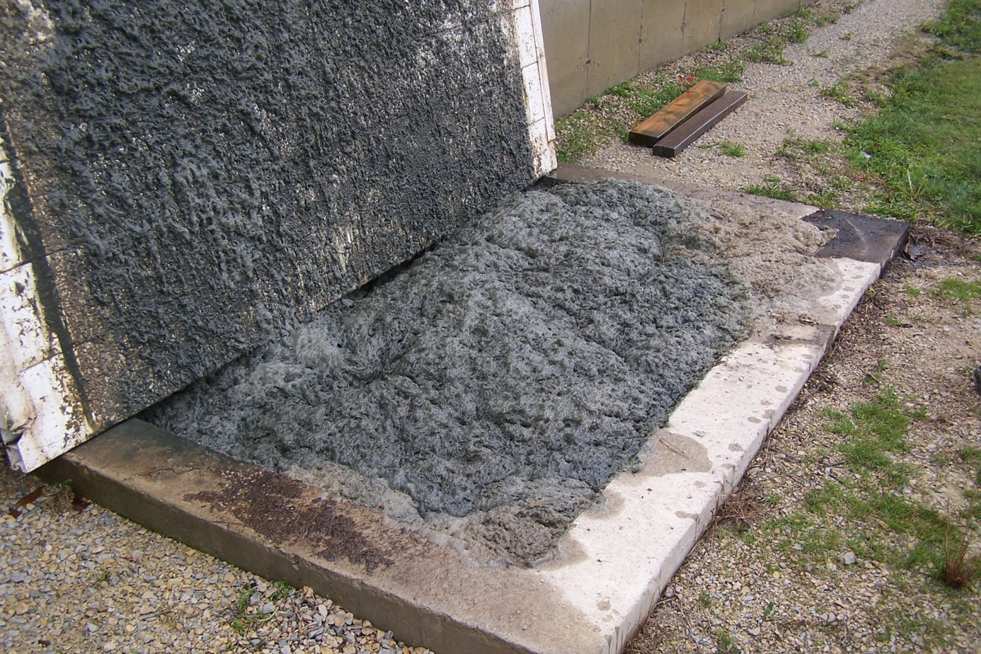
Op Ed Continued…
There may be many causes for the upswing in foaming problems.
26
David Schmidt, Dept of Bioproducts & Biosystems Engineering, University of Minnesota

Slide 27
Op Ed Continued…
Consequences of foaming:
Normally, gases tend to stay in suspension in a liquid; to get out they must break the surface tension
1. Foaming increases surface area.
2. Foaming provides a direct path to the pigs. The gas does not have to disperse and travel through air to get to the pigs.
3. The pigs bite/eat the foam, or the foam breaks, and the pigs die from hydrogen-sulfide.
4. The methane also has a direct path to the confinement area, resulting in higher incidence of methane flash fires.

Slide 28
Op Ed Continued…
The crux of the problem is that confinement advocates have inappropriately transferred wastewater technology from the highly regulated sector of municipal and industrial wastewater to the unregulated – in terms of wastewater – sector of industrial agriculture.
In the wastewater industry, we learned long ago – after workers became ill or died - that we could not put normal workspaces in proximity to areas where fecal waste is decomposing.

Slide 29
Op Ed Continued…
The constant production of the poisonous and explosive gases –
• hydrogen sulfide (H₂S),
• ammonia (NH₃), and
• methane (CH₄)
– was finally taken into account in designing wastewater facilities and technology that would protect both the workers and the surrounding public.
Those protections have been codified in the regulations that control municipal/industrial wastewater technology and design. But industrial agriculture remains exempt.

Slide 30
Op Ed Continued…
To date, the following entities deny that CAFOs are a form of wastewater technology:
• The Iowa Legislature,
• the Iowa Department of Natural Resources, and
• corporate industrial agricultural officials.
Although seeming illogical, in fact a DNR construction permit requires this type of building, resulting in these problems.

Slide 31
This is a local problem.
This is a national problem.
There is no technological fix.
To clean up air, water, and soil, put animals back on the land.
Thank you
Questions?
Bob Watson www.civandinc.net (appendices)
bobandlinda@civandinc.net
563-379-4147
Larry Stone www.larrystonesiowa.com
lstone@alpinecom.net
563-419-6742

